Slide 1


CRICKET LIVE SCORE

Slide 2
PROJECT TEAM:
Arnav Singh(Team Leader)
Tarun Kumar
Rakshit Tyagi
Shashank Tyagi
PROJECT SUPERVISOR:
Dr .VIPIN KUMAR

Slide 3
INTRODUCTION CRICKET LIVE SCORE
The project is about showing lives scores of the cricket match online. Many people don’t have television or cable connection at their place or if they are travelling then they may view the scores online. The system has an admin account where the scores are constantly updated by the admin. Users can login into the account to view the scores anytime. The system also provides a timetable of all the matches that would be going to be held for users to know in prior about the matches. Thus user can view cricket scores in real time.

Slide 4
Advantages
The user can view the scores from anywhere through internet.
Users can keep themselves updated about matches.
The system is flexible to use and is cost-effective.
Disadvantages
Internet connection is requisite for this system.
One cannot view live match if wishes.

Slide 5
Technologies / Software Requirements
We will be using various technologies such as:
• HTML
• CSS & BOOTSTRAP
• JAVASCRIPT
• NODE.js
• MongoDB
• API
• VERCEL
• VS CODE

Slide 6
Hardware requirement / Hardware Used
• Hardware- : Processor i3 or above
• Clock speed- : 3.0 GHz
• RAM size- : 4 GB [MINIMUM]
• Hard Disk capacity- : 500 GB [MINIMUM]

Slide 7
Module Description
•Developing and designing web page- We will be designing the basic layout of the webpage with the help of HTML & CSS.
•Admin login and dashboard-Admin has a login from where he keeps updating the scores in real time. Admin can add different fields like match timetable, match updates, notifications etc.
•User login-User has to first register and login to view the scores. Users can see various timetables and updates in the system.
•Score Updation and Player Information -The scores are constantly updated and posted and also provide a brief description about both the team players playing on ground at that time.
•Timetables The system contains timetables of all the future matches to be held that also keeps on updating
.•Admin notification -Admin is provided an option where he can add notifications in the website for the users. The admin can Add/Update the teams with the details and the user can view the overall information.

Slide 8
Update Live Score – Admin will update the live scores of the match.
Stirke Batsman – No Stirker Batsman – Admin will list the Batsman Order.
Total Runs – Total Balls – 6s – 4s – Stirke rate – Batsman Scorecards will be updated.
Bowler
Total overs – Maiden – Run – Wicket – ER – Bowlers Performance will be updated.
Update Ball by ball runs – Admin will update score for every ball.
Update – Admin will do regular updats on the app.
No Ball, Byes, Leg Byes, Wicket, Retire Hurt , Swap Batswan – Every extras and changes will be updated.
System will add extra without counting batsman and blowler ball count – Extras will be updated in the teamscore but not for the particular player.
Update News – Admin will update the lastest news of the match.

Slide 9
Conclusion
It is concluded that the Webpage works well and satisfy the end users. The application is tested very well and errors are properly debugged. The application is simultaneously accessed from more than one system. Simultaneous login from more than one place is tested. This system is user friendly so everyone can use easily. The end user can easily understand how the whole system is implemented. The system is tested, implemented and the performance is found to be satisfactory. All necessary output is generated. Thus, the project is completed successfully. Further enhancements can be made to the webpages, so that the webpages functions very attractive and useful manner than the present one.

Slide 10
User
View Batsman Score Board – User can view the Batsman Score Board.
View Bowler Score Board – User can view the Bowler Score Board.
View News – User can view the latest news about cricket.

Slide 11
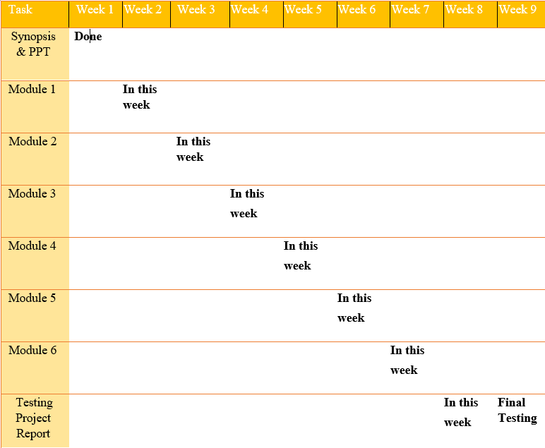
GANTT CHART:

Slide 12
THANK YOU

